Slide 1
DEPARTMENT OF CSE COURSE NAME – ADAPTIVE Software Engineering COURSE CODE – 22CI2001
Session-10
Topic:
Achieving Requirements Traceability
&
Managing Changing Requirements

Slide 2




AIM OF THE SESSION
To familiarize students with the basic concept of requirements traceability
To familiarize students with the basic concept managing changing requirements
INSTRUCTIONAL OBJECTIVES
This Session is designed to:
Demonstrate requirement traceability
Describe the types of traceability, requirements traceability matrix(RTM)
List out the benefits of requirements traceability
Demonstrate how to manage changing requirements in software development
Describe the steps of change management process in the organization
List out the strategy of managing the changing requirements
Describe the suitable process model for requirements change management
LEARNING OUTCOMES
At the end of this session, you should be able to:
Define Requirements Traceability, Categories of Requirement Traceability
Describe types of traceability, RTM and benefits of requirements
Summarize requirements traceability is important component for ensuring the quality of the requirements.
Define software requirements, Change management process
Describe needs of change requirements, management of requirements change
Summarize requirements change means best robust, flexible and userfriendly software

Slide 3
SESSION INTRODUCTION
AGENDA
Requirements Traceability
Categories of Requirement traceability
Types of traceability in the software development
Requirements Traceability Matrix (RTM)
Benefits of Requirements traceability
Requirements Change Management
Steps in change management process in the organization
Factors responsible for requirements change
Requirements change management Process

Slide 4
Requirements Traceability
SESSION DESCRIPTION
Requirements traceability is defined as "the ability to describe and follow the life of a requirement in both a forwards and backwards direction (i.e., from its origins, through its development and specification, to its subsequent deployment and use, and through periods of ongoing refinement and iteration in any of these phases)
In the requirements engineering field, traceability is about understanding how high-level requirements – objectives, goals, aims, aspirations, expectations, business needs – are transformed into development ready, low-level requirements. It is therefore primarily concerned with satisfying relationships between layers of information.

Slide 5
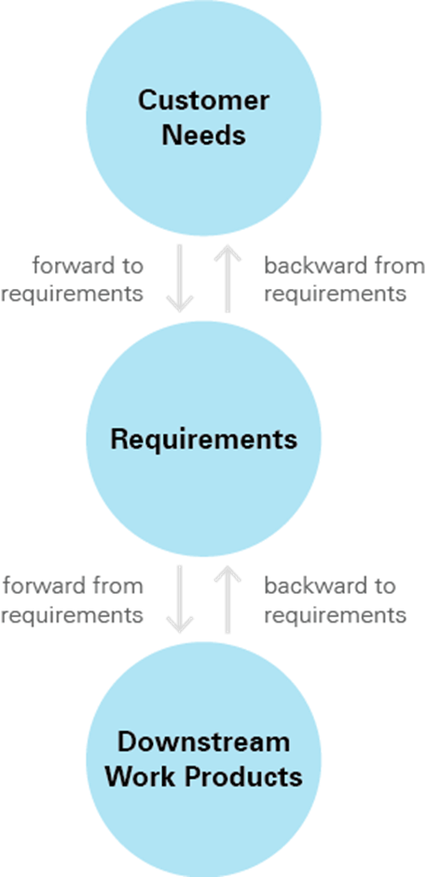
Categories of Requirements Traceability

Slide 6
Types of Traceability in software development
Source traceability – These are basically the links from requirement to stakeholders who propose these requirements.
Requirements traceability – These are the links between dependent requirements.
Design traceability – These are the links from requirement to design.
Testing traceability – These are the links between requirements and test cases, which ensure that each requirement has been properly tested.
Code traceability – These are the links between the requirements and the actual code that is developed to implement those requirements.

Slide 7
Contd..
Version traceability – These are the links between different versions of software or documents, which allow for tracking of changes and updates over time.
Release traceability – These are the links between the requirements and the specific software release or version in which they were implemented.
Risk traceability – These are the links between risks identified in the project and the mitigating actions taken to address those risks.
Business traceability – These are the links between project requirements and overall business goals and objectives.
Quality traceability – These are the links between requirements, design, testing, and implementation, which ensure that quality is maintained throughout the software development process.

Slide 8
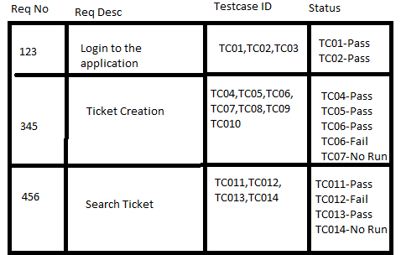
Requirements Traceability Matrix (RTM)
A requirements traceability matrix is a document that demonstrates the relationship between requirements and other artifacts. It's used to prove that requirements have been fulfilled. And it typically documents requirements, tests, test results, and issues.

Slide 9
Benefits of requirements traceability
Management of the solution scope.
Quick evaluation of potential changes.
Reduced project risk.
Promotes consistency between requirements.
Allows monitoring and control across the lifecycle of requirements.

Slide 10
SESSION DESCRIPTION
Requirements change management
Requirements Change Management is the process of identifying, analyzing, tracking, and approving changes to the requirements in software development
The main aim of this process is to minimize the impact of change on the project schedule and costs. It also helps in maintaining the quality of deliverables

Slide 11
Steps in the Change Management Process in Organization
Prepare the Organization for Change.
Craft a Vision and Plan for Change.
Implement the Changes.
Embed Changes Within Company Culture and Practices.
Review Progress and Analyze Results.

Slide 12
Factors responsible for requirements change
Customer needs
Market change
Global competitors
Government regulations

Slide 13
Requirements Change Management Process
There are 3 phases of effective handling of requirements change management
Phase 1: There are 3 preconditions
Precondition 1: Flexible Planning
Impact of requirement change depends upon Project type and project stage. It is obvious requirements are freeze in early stage and depends upon type of the project. So, flexibility for requirement change can be gained by optimising the tasks and shifting decision to later project stages.

Slide 14
Precondition 2: Changeable requirements
Changing requirements create risks, so it is needs to analysis for each specific change. It includes following
Traceability: Record the interdependencies of requirements and assessed the impact of change in the software
Rationale: Check change is rationale or not
Owner: who is responsible for change in requirement and should be able to connect all changes and links in the different modules of the software.

Slide 15
Precondition 3: Requirements change management Policy and Process .
There are some key characteristics regarding requirement change management policy and process.
Change request - Who can submit a change request? What information has to be included in a change request? - Develop a change request form
Change control board - Who will be involved in the decision-making process? How will the communication be performed? - Set up a change control board
.

Slide 16
Contd..
Decision making - What are the criteria that are taken into account when making the decision? - Develop a decision matrix template
Approval - Will the project scope (budget and schedule) change? Who has to approve the change? - Involve these stakeholders early and convince them of the benefits of a necessa ry change
Change plan - What has to be done to implement the change? When does it have to be done? How can it be tracked? A change plan should tell you how to get from the current situation to the desired situation

Slide 17
Phase 2 - Dealing With Change Requests
Think before you act
When a change request comes in, it tends to create disorder. Your first priority should be keeping the project on track - on budget and schedule. Before you leave the proven path, make sure that the new path is clear of obstacles. And make sure you have the approval of the relevant stakeholders. Until then: Follow your existing project plan - and its objectives.
Understand The Problem
When you have ensured good traceability of your requirements, it might be easy to analyze the impact of the requested change. But will the change be sustainable?
Understanding the reason behind the change request will help to answer this question. And the answer is useful. Nobody wants to change a new requirement again after a few weeks because the first change did not solve the problem.

Slide 18
Consider Alternatives
If you understand the problem behind the change request, you may think about alternative solutions. Maybe the solution proposed in the change request is not the most effective to solve the problem. Probably you will find a solution that meets the needs of the request and makes your life easier.
Create Involvement
When there is change - there is opposition. A proven strategy in requirements change management is involving the affected people. Those who fund your project - and those who have to work with the change. If their concerns are taken into account, there will be a sustainable solution and happy people. Who would resist that opportunity?

Slide 19
Tip 4 - Create Involvement
Get the approval
At some point it is time to stop thinking and start acting. There is a final step that should be taken before implementing the change: the approval.
By now you will have found out whether the change is necessary and beneficial. Will it also affect the budget and the schedule? In case the project end date shifts to a later date or you need to spend more money, You will need the approval of some of your stakeholders. Now it is the time to get it.
Make a plan
You already knew where you were. And now you also know your new destination. But how can you get there? A change is a project in itself . Take it seriously. Find out what has to be done. Define who will do it and when it has to be completed; and how the progress can be measured. And record all that in a requirements change plan (which could be as simple as an action list).

Slide 20
Phase 3 Implementing Change
Configuration Management :Before you start implementing any change it may be wise to record the configuration. In particular if it is a working one. From that point, Its recommend logging any change. In case things happen to go wrong at some point, a change log will be a fountain of knowledge to get back on track. And this is not only for software projects.
Communication :If you haven't already done it - now it is the time: inform everyone who is affected by the change. What information needs to be given? Here are just a few questions to hear when changes appear: What was the problem? What is the solution? How does the solution solve the problem? How am I affected? What do I have to do? When does it have to be done? .Communication should not be one way only. Keep your ears open while change is being implemented. You might find out about unexpected events before they cause damage.

Slide 21
Monitoring
One of my tips was to establish an effective plan to implement the change. Monitoring shall assure that this plan is followed. But there is also a second purpose. Most probably during implementation it turns out that some things do not develop as planned. By monitoring you obtain the information that is necessary to react to unforeseen development. It enables you to adapt the plan accordingly.
Verification
How can you measure the effectiveness of your requirements change management activities?
One criteria is that the problem is solved. How can you verify this? Perform a formal check-out review within the change control board. Of course the originator of the change should participate. Once you verified that the problem is solved, formally close the change process.
Another criteria is that the project is still on track after the change.

Slide 22
SELF-ASSESSMENT QUESTIONS
Define Requirements Traceability
Describe the types of traceability in the software development.
Describe the requirements traceability matrix and draw the sample template.
Describe Benefits of requirements traceability.
Define Requirements change management.
What are factors responsible for requirements change management?
Describe the process of requirements change management
Describe the change management process in the organization.
What are the benefits of requirements change management?

Slide 23
REFERENCES FOR FURTHER LEARNING OF THE SESSION
TEXTBOOKS:
Roger S.Pressman, “Software Engineering – A Practitioner’s Approach” 7th Edition, Mc Graw Hill,(2014).
Ian Sommerville, “Software Engineering”, Tenth Edition, Pearson Education, (2015).
Reference Book
Agile and Iterative Development: A Manager's Guide, Craig Larman, Addison-Wesley
WEB REFERNCES/MOOCS:
https://www.digite.com/kanban/what-is-kanban/
http://www.scaledagileframework.com
https://www.guru99.com/test-driven-development.html
https://junit.org/junit5/

Slide 24
THANK YOU
Team – Adaptive Software Engineering

